Slide 1
Pseudo crisis
Google’s hypothetical road to hell

Slide 2

What is the case?
A drop in internet giant Google`s stocks with 8% at the end of the working day lead to a collapse in few indices at the NY stock exchange. This is a result from the preannouncement of the company`s report showing low incomes and 20% decrease in profit compared to the same period for last year. Stocks were traded at $754but after the release of the report their price collapsed to $676. Then Google stopped trading for two and a half hours at $687. When trade was reopened, Google`s stocks went up slightly but after all dropped with 8% or $60.49, reaching $695 at the end of the day. All that lead to writing off of assets for $19.8 billion of company`s market value and a decrease of 1% of high-tech enterprises index NASDAQ. Other indices closed the day with smaller losses. NASDAQ dropped with31 points to 3.073. The industrial index Dow Jones fell with 8 points to13.549, while Standard & Poor’s 500 index fell with 4 points to1457.

Slide 3
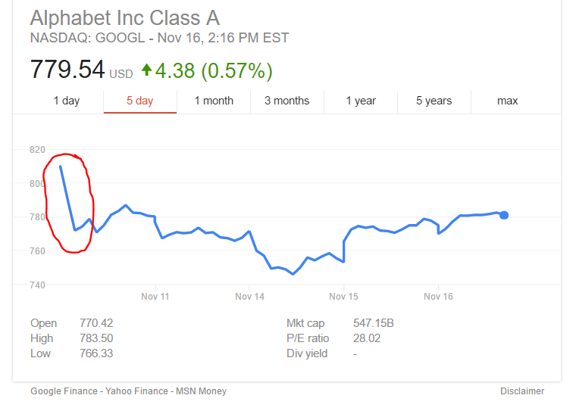
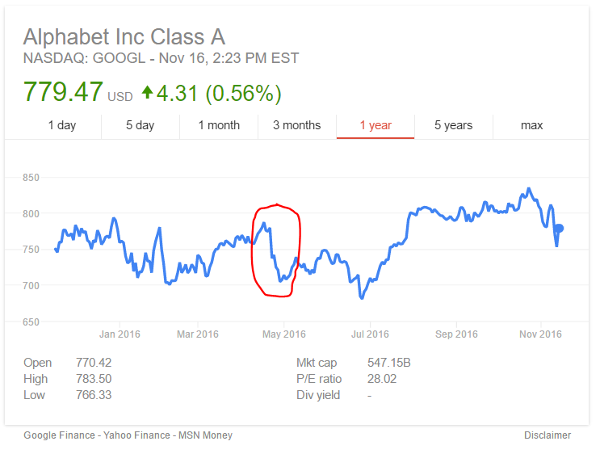
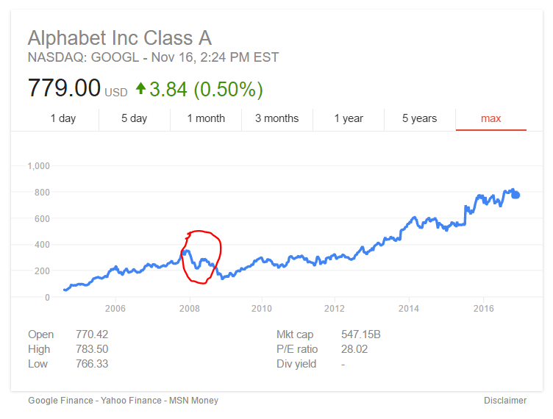
Some examples in order to understand better
Last Friday’s drop in price was $42 within 3 hours.
Ten day constant drop resulting a loss of $82 per share.
And of course the recent financial crisis first blood; $140 drop per share in the course of 3 months.
However non of these is as spectacular as $60 for 8 minutes because of a technical mistake.

Slide 4
Google’s internal environment
Internal environment consists of the events and trends within an organization that affect the management, employees and organizational culture.
Like every company of its size google has an abundance of resources and potential for aggressive expansion waiting for its moment to come.
The most important of these are vast financial capital, human resources and the culture within, their strive for innovation and competitiveness and Google's decades old reputation.

Slide 5

Philosophy
The company has always managed to make an impression that to them maximizing the profits from their ventures isn’t the most important aspect of their work. They approach situations having in mind their priority which is keeping their clients satisfied while striving to find new ways and patterns.
“It’s really the people that make Google the kind of company it is. We hire people who are smart and determined, and we favor ability over experience. Although Googlers share common goals and visions for the company, we hail from all walks of life and speak dozens of languages, reflecting the global audience that we serve.” -Google’s culture

Slide 6
Some of Google's maxims
“Crazy definitely triumphs comfy at Google”
“If we don’t have any of these mistakes we’re just not taking enough risks”.
Get Uncomfy: That means never settle into an equilibrium (a.k.a. "rut"), but don't fall apart either (a.k.a. the "chaos trap")
Pace Yourself: The goal should be creating an internal rhythm, not just moving fast for the sake of speed.

Slide 7

External environmental factors

Slide 8
Political Factors
There is widespread criticism that Google is a monopoly. This has led to antitrust action, particularly in Europe. There have been calls for Google to be broken up or for it to change the way it conducts searches.
There has also been some criticism that Google has too much control over the flow of information to the point of changing the outcome of elections. This could lead to calls for nationalization or stricter government oversight of Google.
Google is one of many U.S. companies that stashes cash in foreign bank accounts to avoid high American corporate income taxes. There is growing political pressure in the United States to force these companies to bring that money into the country.
Additionally, Google has not been able to enter some potentially lucrative markets, such as China, which limits the company’s growth.

Slide 9
Economic Factors
Alphabet has accumulated a huge amount of cash, which makes it very vulnerable to inflation. A sudden drop in the value of a currency could reduce the company’s value.
The volume of Google revenues is subject to the impact of a set of macroeconomic factors such as inflation rate, the value of USD, interest rates, relevance of economic slowdown and others. However, it is interesting to note that impacts of some of the above factors on Google performance has proved to be different compared to the impact of the same factors on many other businesses within and outside e-commerce industry.

Slide 10
Social Factors
A decline in the use of traditional laptop and desktop computers, which historically have been the most popular means of accessing Google, more searches were done from mobile devices than computers for the first time during the summer of 2015.
Growing use of social media solutions such as Facebook and WhatsApp for activities traditionally done on the Internet. This includes search, streaming video, shopping and money transfer.
Google has not been able to translate its success in traditional search to shopping search. Around 30% of all online shoppers start their search at Amazon. That makes it hard for Google to cash in on such transactions.
YouTube has become less dominant of a video sharing platform as more and more companies launch their own alternatives to traditional television.

Slide 11
Technological Factors
technological external factors significant in Google’s external environment include Growing Internet access in developing countries and Rapid adoption of mobile devices in the global market.
Google faces significant opportunities based on these technological external factors. The company can expect higher advertising revenues as developing markets become more connected online. Also, Google can improve the mobile-friendliness of its online products to exploit the mobile trend.

Slide 12
Legal factors
regulations on online privacy and intellectual property have been initiated by google.
criticism of the company over issues such as aggressive tax avoidance, search neutrality, copyright, censorship of search results and content, and privacy have been brought up. Other criticisms include alleged misuse and manipulation of search results, its use of others' intellectual property, concerns that its compilation of data may violate people's privacy, and the energy consumption of its servers, as well as concerns over traditional business issues such as monopoly, restraint of trade, anti-competitive practices, and patent infringement.

Slide 13
Scenario #1 Google remains stable; competitors remain stable
Due to the recession all around the world, Online advertising is becoming more and more popular and google thrives on this contrary to the popular belief. Some companies would be forced to close their physical locations and move entirely online to minimize expenditures. As history has proven, google actually remained resilient and even benefited from the downturn of the economy.

Slide 14
Scenario #2 google remains stable; competitors decline
Google would continue to hold its top spot, whereas competitors will have difficulty keeping up. businesses are looking for ways to compensate their losses and would cut entirely or at least partly drift off of most traditional forms of advertising which are more expensive.

Slide 15
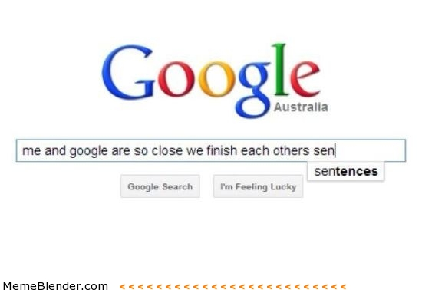
Scenario #3 google is unstable; competitors remain stable
(Still has the upper hand)
This is the scenario which took place. Google did not meet its financial projections by 20% in profit and in the air there was everything but love. Many thought this was a pivotal point in Google's history and nothing would be the same. However largely due to its large capital and influence they managed to bounce back.

Slide 16
Scenario #4

Slide 17
Scenario #5

Slide 18
Scenario #6

Slide 19
Scenario #7 Google is unstable; hacker attack
Passing through security system of every single company, institution or organization it is considered as the worst threat that could be faced. Hacking the general core leads to some detrimental consequences. Personal details, banking accounts and every type of information could be revealed. In the most cases loses cost millions. What will be the worst scenario if google is under cyber attack? Such action will inevitably destabilize the company. Even though google has one of the best security systems, the danger of penetration still exists. This will lead to collapse of indices and google influence on the marker will decline. company’s competitors will immediately take advantage of the situation and this will shake the google’s positions.

Slide 20
Team information: X02
Members:
Nikola Petkov Petkov, 16114031
Danislav Plamenov Gurbalov, 16114030
Viktor Georgiev Dardanov, 16114002
Damyana Dimitrova Dolzheva, 16114001
Vasil Lubomirov Neshev, 16114026

Slide 21
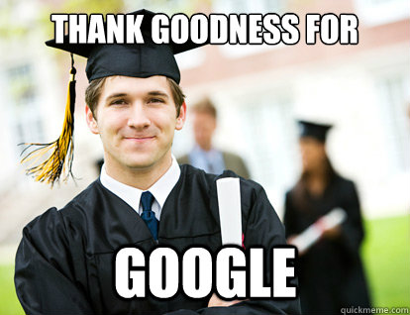
Special thanks to
www.ua.basaga.org
http://panmore.com/google-pestel-pestle-analysis-recommendations
www.prezi.org
And of course

